Slide 1
Class 2
The State of Play in International Trade and Trade Policy II:
Other by
Alan V. Deardorff
University of Michigan
2020
PubPol/Econ 541

Slide 2
Announcements
Use Chat to say you want to ask or answer questions. I’ll call on people in order.
Note that if I don’t get through all of my slides, you should view them later. (But not the Sep 1 class.)
Office hours:
  Feel free to enter even if others are there
  If you want a private meeting, email me to schedule
Give me feedback on the quiz

Slide 3
Pause for News

Slide 4
State of Play: Other
Outline
  Background from KOM
  Brexit
  Pandemic and Trade
  Other Disputes and Actions

Slide 5
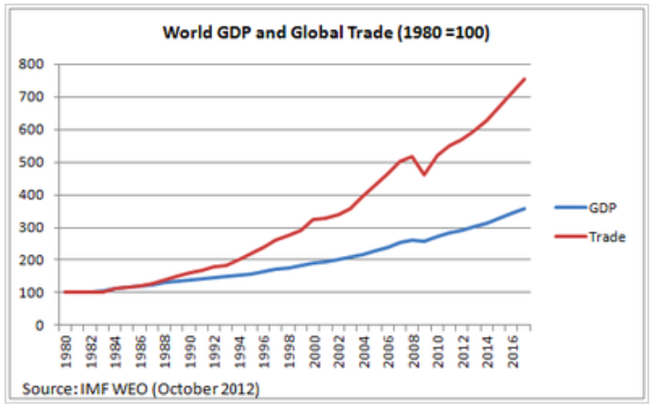
World Trade Growth
Notes:
https://g2reports.weebly.com/reports.html

Slide 6
Pause for Discussion

Slide 7
  Questions from KOM
How much has trade grown? why?
Who gains from trade?
What trade between two countries depends on?
Why is the gravity model useful?
Do national borders interfere with trade?
Why is trade in services growing?

Slide 8
Brexit
Brexit Timeline
  Jun 23, 2016: Referendum
    UK votes to leave EU
  Mar 29, 2017: EU exit provision triggered
    UK PM initiates 2-year exit process
  2019: Several extensions asked and given
  Jan 31, 2020: UK leaves EU
    Transition period (policies unchanged) thru 2020
  Dec 31, 2020: Transition period ends
Notes:
Walker, Nigel, ” Brexit timeline: events leading to the UK’s exit from the European Union,” House of Commons Library, June 10, 2020.
https://commonslibrary.parliament.uk/research-briefings/cbp-7960/

Slide 9
Brexit
Brexit policy implications if no “deal”
  UK-EU tariffs revert to “WTO levels”
  All other policies revert to those on outside countries
    Regulations on products and services
    Rights of foreign residents
    Rights of foreign companies
  UK-EU borders become international borders
    Including between Ireland and Northern Ireland

Slide 10
Pause for Discussion

Slide 11
  Questions on Brexit
What are the policies involved in the issue of the “level playing field”?
What do UK and EU want regarding fisheries?
What other issues is the EU concerned about?
Why will Dover need a new truck plaza?

Slide 12
Pandemic and Trade
Drop in trade, due to
  Factory shutdowns, first in China, then elsewhere, cutting supply
  Supply chains interrupted, cutting supply even from factories not shut down
  Incomes fell as jobs were lost, cutting demand
  Some shipping, and most air transport, stopped due to virus (much normally rides with passengers)
Notes:
Walker, Nigel, ” Brexit timeline: events leading to the UK’s exit from the European Union,” House of Commons Library, June 10, 2020.
https://commonslibrary.parliament.uk/research-briefings/cbp-7960/

Slide 13
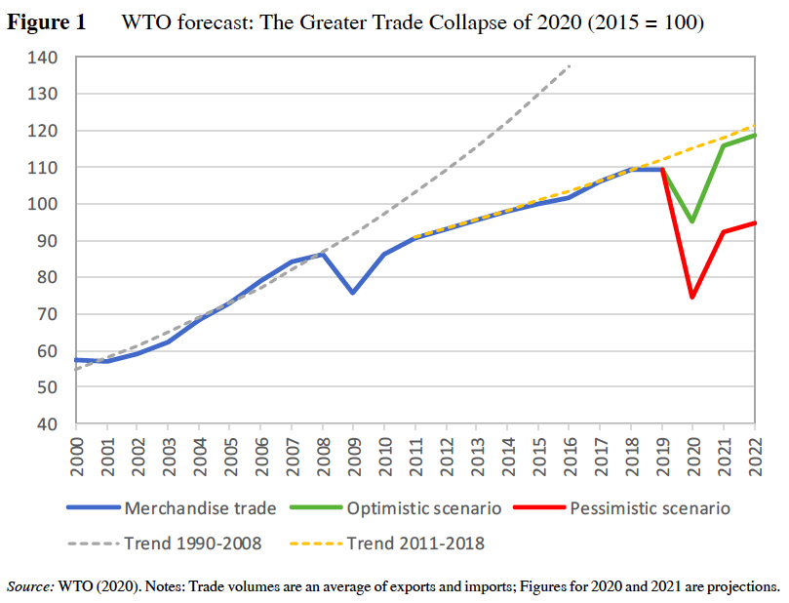
Notes:
Baldwin, Richard and Simon J. Evenett, “Introduction,” in Richard E. Baldwin and Simon J. Evenett, eds., COVID-19 and Trade Policy: Why Turning Inward Won’t Work, CEPR Press, 2020.

Slide 14
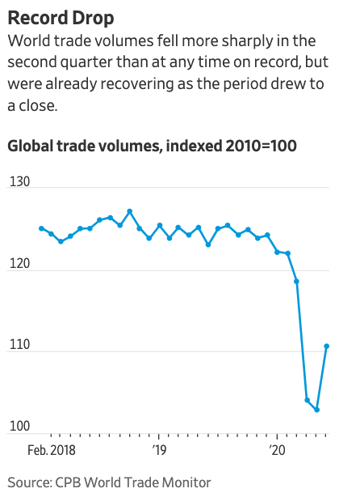
Source: WSJ 8/26/20
Notes:
Hannon, Paul, “Covid Crisis Drives Historic Drop in Global Trade,” Wall Street Journal, August 26, 2020
https://www.wsj.com/articles/covid-crisis-drives-historic-drop-in-global-trade-11598368752?mod=itp_wsj&ru=yahoo

Slide 15
Pandemic and Trade
Effects on policies
  Export bans to keep in tools to fight virus
  Import bans to keep out virus
  Tariff reductions (just a few, to help needed access, mostly on medical supplies)
  A group of countries committed to “keeping supply and trade links open” for “essential goods, especially medical supplies”
Notes:
Walker, Nigel, ” Brexit timeline: events leading to the UK’s exit from the European Union,” House of Commons Library, June 10, 2020.
https://commonslibrary.parliament.uk/research-briefings/cbp-7960/

Slide 16
Pandemic and Trade
Other effects
  Seamen stranded on board
  Kenya bans imports of used clothing
  Countries race to be first with vaccine
  Increased desire for self-sufficiency
  Concern about trade in wildlife
  Trade in education suffers
  Price of oil became negative
  Concern about reliance on China for PPE
Notes:
Walker, Nigel, ” Brexit timeline: events leading to the UK’s exit from the European Union,” House of Commons Library, June 10, 2020.
https://commonslibrary.parliament.uk/research-briefings/cbp-7960/

Slide 17
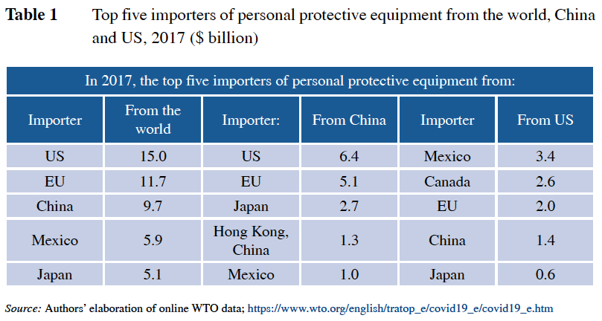
Notes:
Baldwin, Richard and Simon J. Evenett, “Introduction,” in Richard E. Baldwin and Simon J. Evenett, eds., COVID-19 and Trade Policy: Why Turning Inward Won’t Work, CEPR Press, 2020.

Slide 18
Pause for Discussion

Slide 19
  Questions on Pandemic
Is trade being hurt more than the WTO expected?
Why is the current trade collapse bigger than that in 2008-9?
Why don’t export bans work to protect access to covered products?
Does the GATT/WTO have rules against export restrictions?

Slide 20
Other Disputes and Actions
Disputes
  Boeing-Airbus
    Whiskey tariffs
  US requirement of Hong Kong “made in China” label
    Hong Kong says contrary to WTO
  Counterfeit goods from China
    US cracks down
  Forced labor in supply chains
    Australia reports forced labor in Xinjiang
Notes:
Walker, Nigel, ” Brexit timeline: events leading to the UK’s exit from the European Union,” House of Commons Library, June 10, 2020.
https://commonslibrary.parliament.uk/research-briefings/cbp-7960/

Slide 21
Other Disputes and Actions
Actions
  Stopping foreign investments
    By CFIUS
    By Australia of China dairy takeover
  Honoring geographical indicators (EU, China)
  Ban of frozen meat (by region of China)
  Tax breaks for reshoring (Trump?)
Notes:
Walker, Nigel, ” Brexit timeline: events leading to the UK’s exit from the European Union,” House of Commons Library, June 10, 2020.
https://commonslibrary.parliament.uk/research-briefings/cbp-7960/

Slide 22
Other Disputes and Actions
Actions
  EU eliminates tariff on US lobster
    First negotiated tariff reduction in 20 years
    Pushed by US due to Canada-EU FTA
  Increased checking of containers for smuggling
Notes:
Walker, Nigel, ” Brexit timeline: events leading to the UK’s exit from the European Union,” House of Commons Library, June 10, 2020.
https://commonslibrary.parliament.uk/research-briefings/cbp-7960/

Slide 23
Pause for Discussion

Slide 24
  Questions on Disputes & Actions
Boeing-Airbus Dispute:
  Why are US tariffs on the EU permitted?
  Why can’t the EU retaliate?
What will Airbus do to end the dispute?
What is CFIUS, and is it new?
On what basis may investments be blocked?
What are “geographical indicators”?

